Slide 1
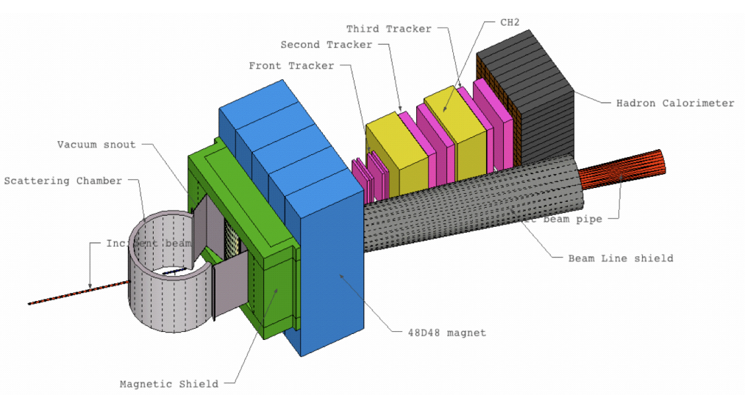
HCAL-J Status
SBS Collaboration Meeting
July, 2014
G. B. Franklin
Carnegie Mellon University
Hadron Calorimeter
HCAL-J
Carnegie Mellon
INFN, Catania
JLab
7/8/2014

Slide 2
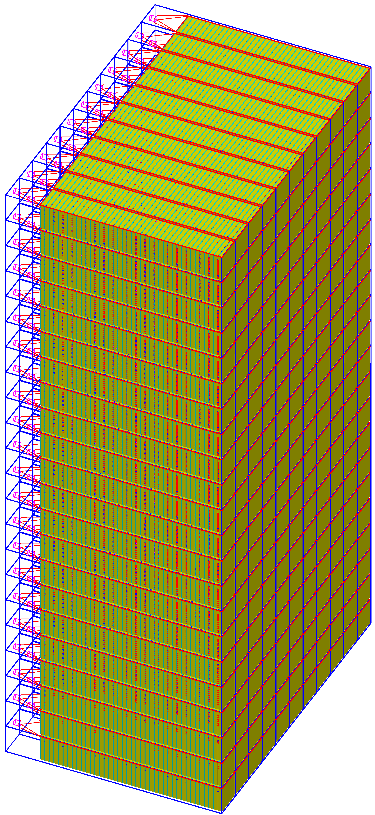
HCAL-J Design
Modular Design:
  15 cm x 15 cm x ~ 1m modules
  40 layers scintillator and iron per module
  288 Modules (39 tons)
24 Modules (360cm)
Wavelength Shifter
PMT
Rectangular to cylindrical
Light Guide
Scintillators
Absorbers
12 Modules (180 cm)
HCAL-J concept is based on COMPASS HCAL1, but…
  Faster scintillator and wavelength shifter
  Wavelength shifter moved to center
  2 inch PMTs faster, better quantum efficiency
288 modules for JLab HCAL

Slide 3
From Draft HCAL-J Statement of Work
Time Resolution
Simulations show that an rms time resolution of 1.0 ns from the HCAL detector, would result in a trigger efficiency of 80% for the GEn experiment. This is acceptable as the minimum performance criteria, but the HCAL module geometry, scintillator materials, and waveshifters will be optimized to obtain a time resolution better than 1.0 ns rms with an overall goal of achieving a time resolution closer to 0.5 ns rms.

Slide 4
COMPASS HCAL Module Muon Timing Resolution
From Oleg SBS Presentation, Mar. 2012
Time Resolution: 620 ps

Slide 5
From DOE Review Presentation, Nov. 2013

Slide 6
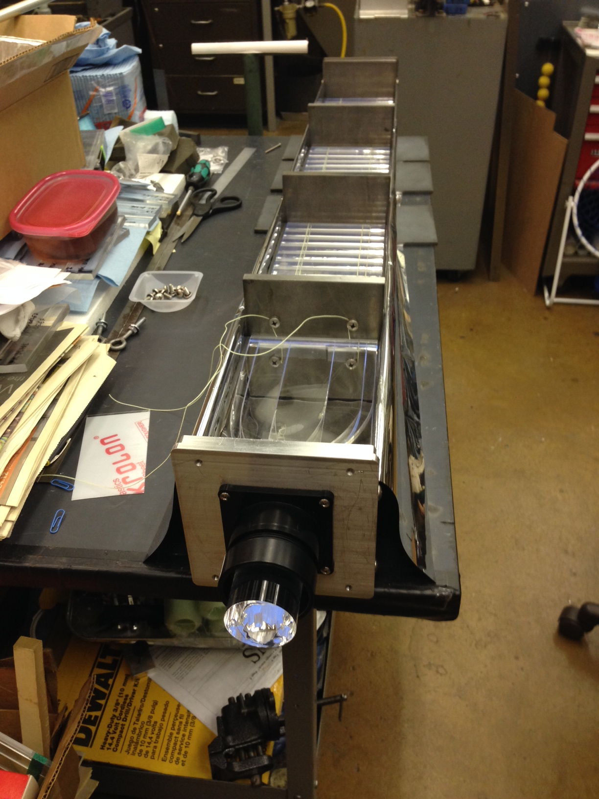
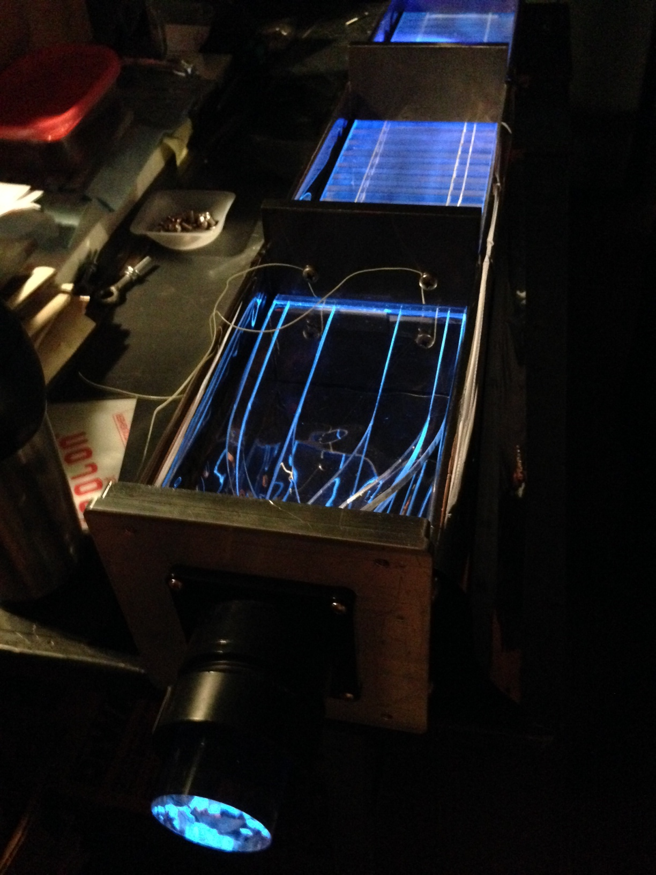
Proto-2 Construction and Testing
HCAL-J Proto1 (Mechanical Prototype) Completed Fall 2013
Custom Extruded Scintillator delivered to CMU Jan. 2014
HCAL-J Proto2 (Working Prototype) Completed May. 2014
Timing Test Results June, 2014
Proto 2
50% loaded
50 % Loaded
Lit with UV LED

Slide 7
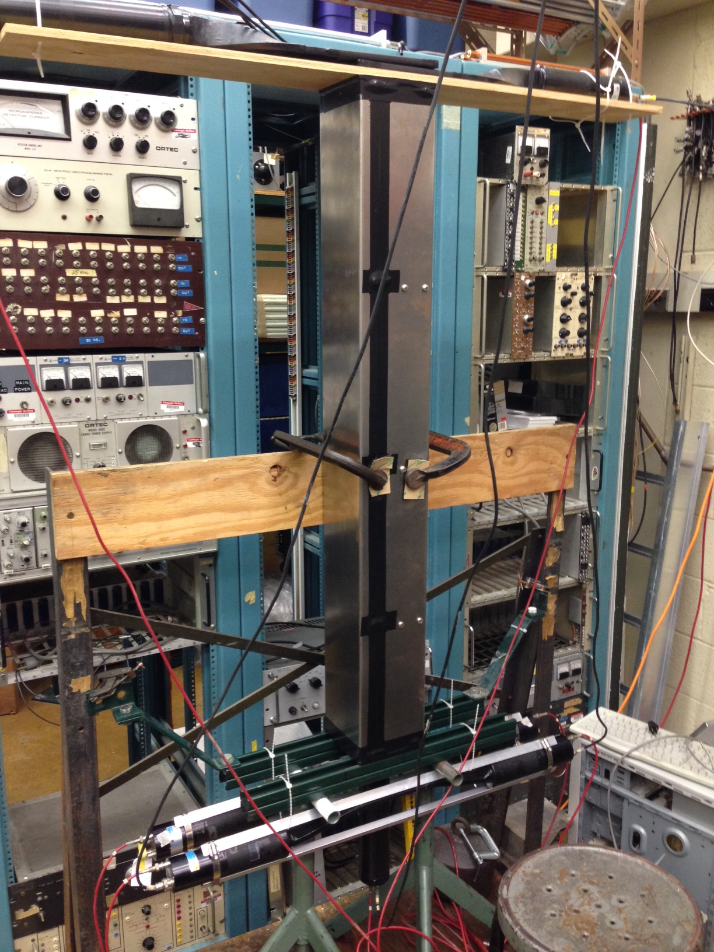
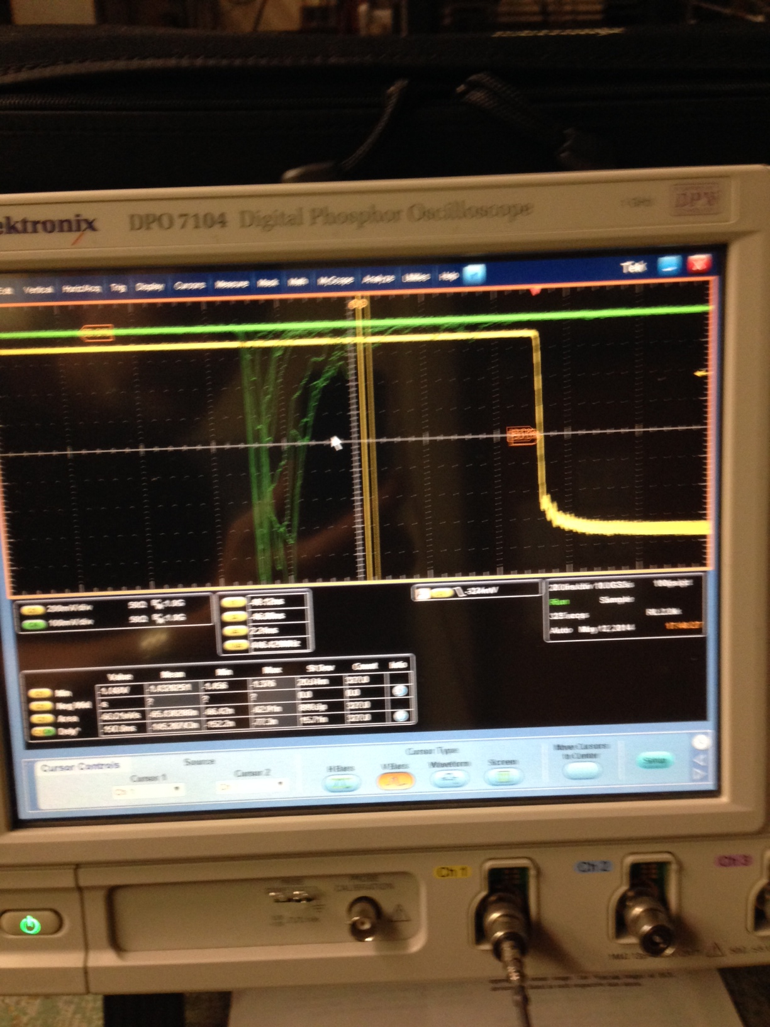
Cosmic Ray Test Setup
Trigger
Scintillators
Proto 2
Trigger &
Timing
Scintillators
Set up for cosmics
First pulses from cosmics

Slide 8
Vahe’s First Proto2 Cosmic Ray Measurements
T_{HCALJ} –T_{trigger} (ns)
ADC Channel
ADC Channel

Slide 9
Cosmic Ray Timing Measurements
T_{Trig1} – T_{Trig2} (ns)
T_{HCALJ} - (T_{Trig1} +T_{Trig2})/2 (ns)
HCAL-J Proto-2 Muon Time Resolution
Start-time corrected: σ = 340± 13 ps
Expect σ ~265 ps if photo-electrons doubles with better light guide
Note: COMPASS HCAL cosmic measurements: σ = 620 ps

Slide 10
  Simulated Hadron Time Resolution V. Mamyan
750 ps
Tuned for measured intrinsic resolution
But no significant improvement predicted for improved light guide
Note: COMPASS HCAL 2.7 GeV neutron simulation: σ = 1.64 ns

Slide 11
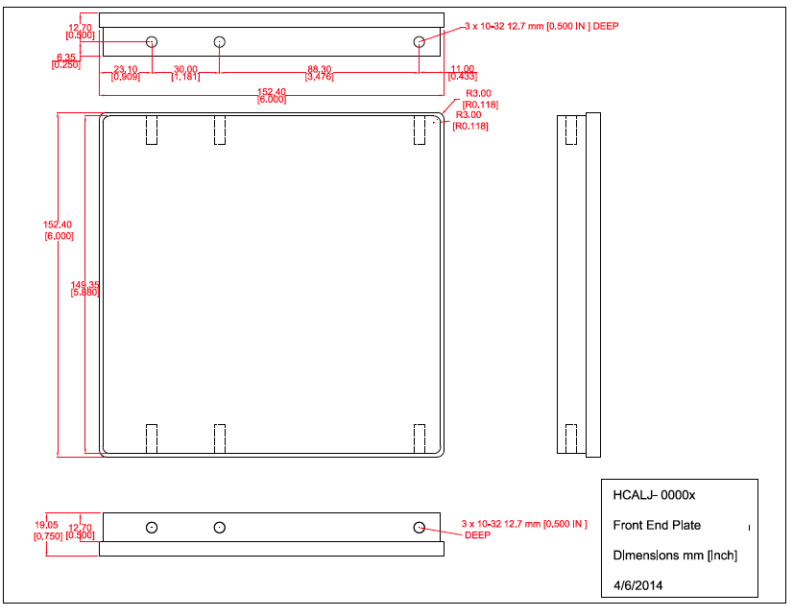
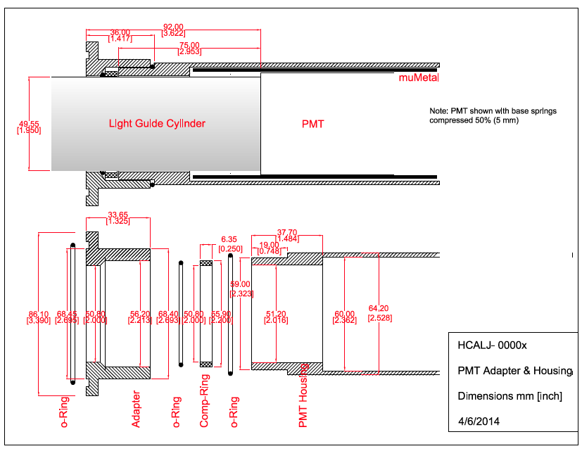
Status of Production Preparation
Design documentation in progress
Design Documentation in progress

Slide 12
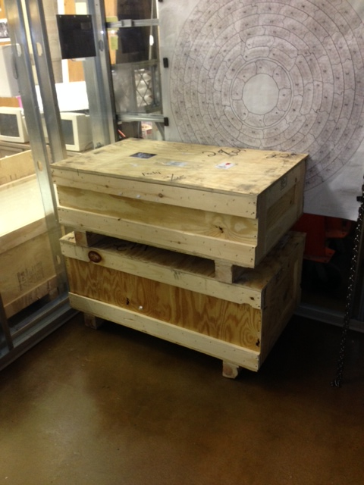
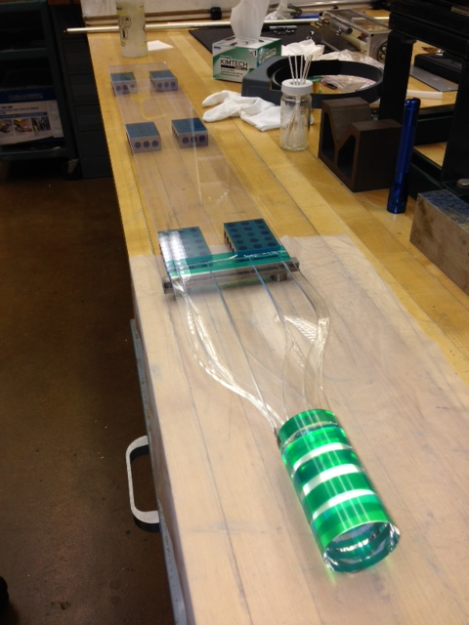
Major Components
Wavelength Shifters Acquired
300 BC-420 Wavelength Shifters
Purchased from St. Gobain by INFN
Received at Carnegie Mellon
Light Guide Design Changes
Injection-molded components tested:
Poor light transmission
Laser-cut components tested:
Achieved adequate transmission
change to 3-piece design?
Next prototype in a couple weeks
Will test hydrogen-oxygen flame polishing
Crates of WLSs
5-piece laser-cut Light Guide

Slide 13
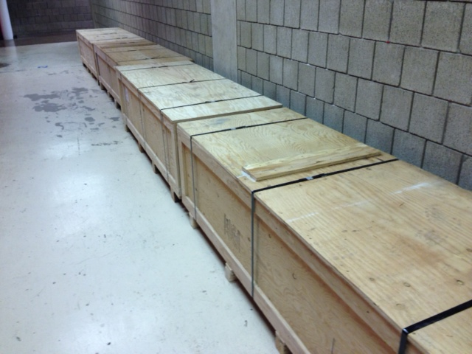
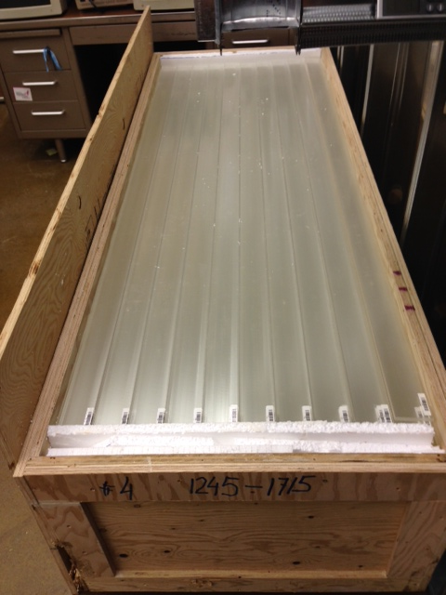
Custom Extruded Scintillator Delivered to CMU in March !
Produced by FNAL Extrusion Facilities
1 cm x 69 cm x 3.6 km
Thanks to Dr. Anna Pla-Dalmau
First 80 pieces cut (1 module), only 24,000 to go
5 Crates of Scintillator (3.6 km)

Slide 14
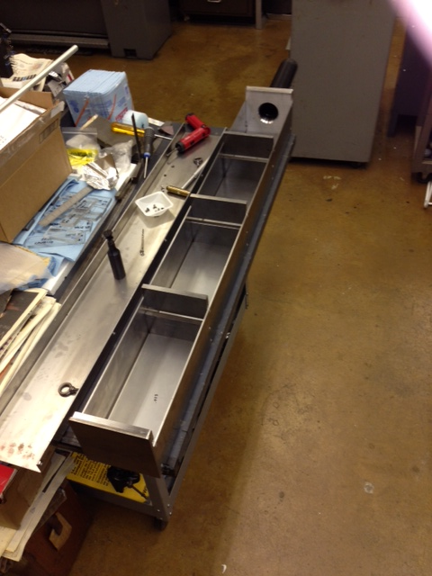
Major Remaining Components
28 tons of Iron absorbers
Purchased by JLab & INFN
9 tons to be delivered to CMU Friday
Near future
  24,000 cut scintillator pieces
  1,800 Iron ribs (with tapped holes)
  300 Aluminum back end plates
  300 Iron front end plates
  300 Cans and lids
  LED/fiber optics monitor system
  HCAL-CAL (B. Quinn)
Future Milestones
Module construction initiated: October 2014 (+4 months float)
Module assembly 50% completed: March, 2016 (+4 months float)
Construction is completed: September 2016 (+9 months float)

Slide 15
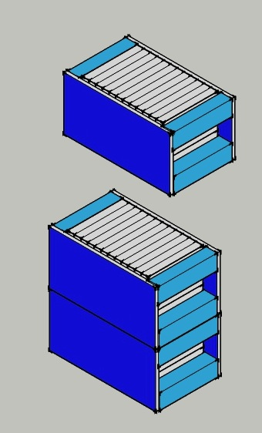
Further Future: Subassembly
Note: HCAL-J module 270 lbs.
288 Modules -> 39 tons (+ front plate + stand)
HCAL-J to be stacked in 4 subassemblies suitable for 20 ton crane
Mechanical Engineer undergrad performing SOLIDWORKS-based deflection studies
Exo-skeleton Crustacean
Design

